Slide 1
Library management systems
LMS(Organizing Knowledge, Simplifying Access)

Slide 2

TEAM
P.BHAVIDHYA REDDY - AP23110010266
Siva Nikshya - AP23110010285
Yagna Sri - AP23110010297

Slide 3
Overview
LMS
WHAT IS LMS?
USES OF LMS
IMPACTS OF LMS
LMS CODE

Slide 4


WHAT IS LMS?
Library Management System (LMS):
A software application designed to efficiently manage library operations. It helps librarians and users to catalog, track, and access library resources like books, journals, and digital materials.

Slide 5

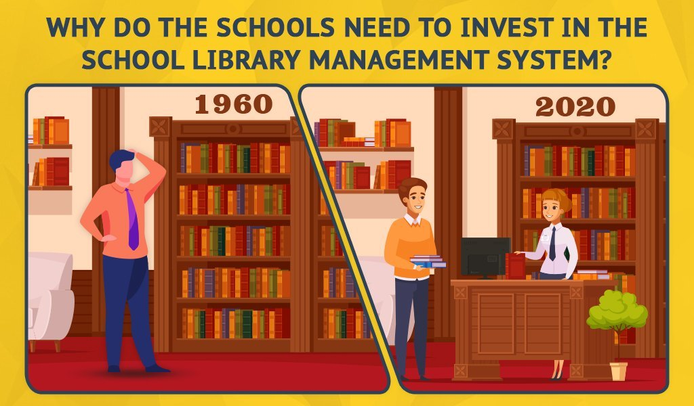
USES OF LMS
Organizing Resources:
Efficiently catalog books, journals, and digital materials.
2. Time-Saving:
Speeds up routine tasks for Librarians and users.
3. Streamlining Operations: Reduces manual work and paperwork.

Slide 6

IMPACTS OF LMS
Cost-Effectiveness:
Reduces the need for manual work and paper-based processes.
2. Improved Access:
Makes resources easily available to users.
3.Better Organization:
Ensures systematic cataloging and tracking.

Slide 7

LMS CODE
PROBLEM STATEMENT:
Traditional library systems are inefficient, error-prone, and limit access to resources. An LMS streamlines operations and enhances user experience with automation and digital integration.

Slide 8
LMS CODE
Solutions:
Challenges:
Manual errors in resource tracking and management.
Limited access to
digital resources.
Inefficient and time-consuming processes.
Automate cataloging and tracking with LMS.
Integrate digital resources for easy access.
Streamline workflows to save time and reduce errors.

Slide 9
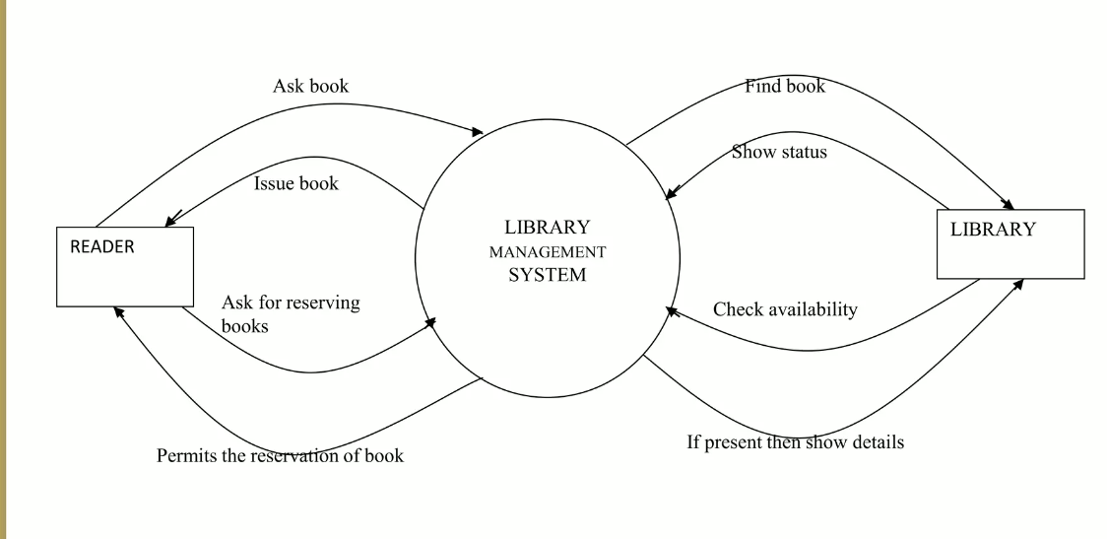
LMS CODE(FLOW CHART)

Slide 10
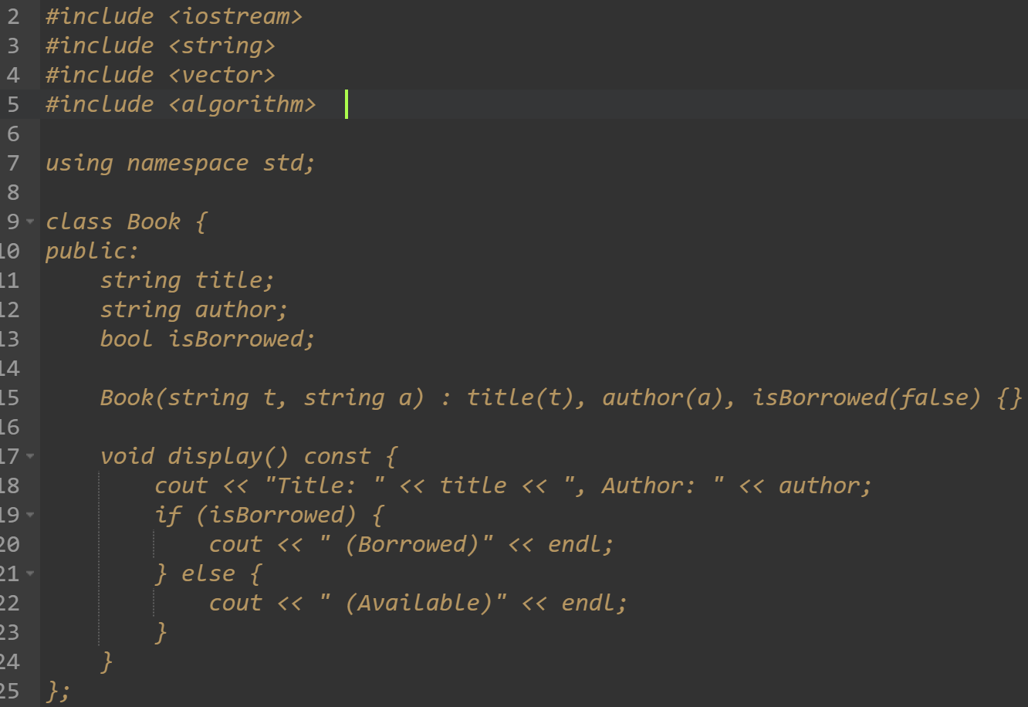

CODE OF LMS
Class Book:
Represents books in the library.
Attributes:
title: Title of the book.
author: Author of the book.
isBorrowed: Indicates availability
Key method: display().

Slide 11
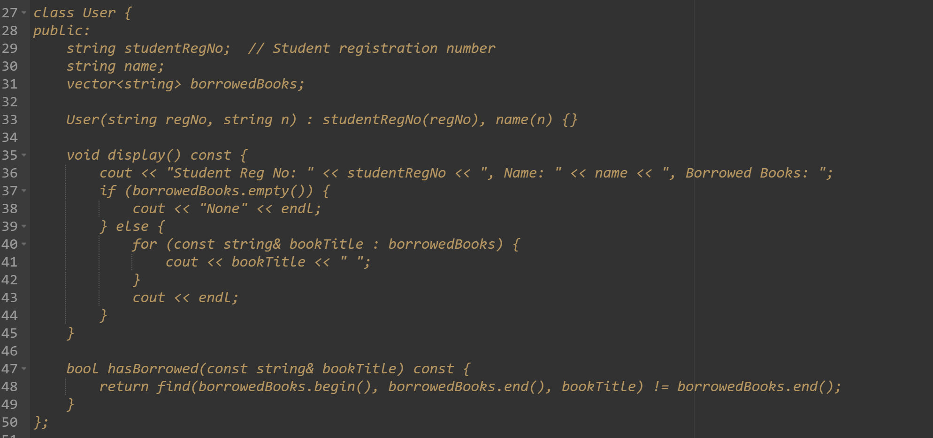
CODE OF LMS
Class User:
Represents users of the library.
Attributes:
student RegNo: Registration number.
name: Name of the user.
borrowedBooks: List of borrowed book titles.
Key methods: display(), hasBorrowed().

Slide 12
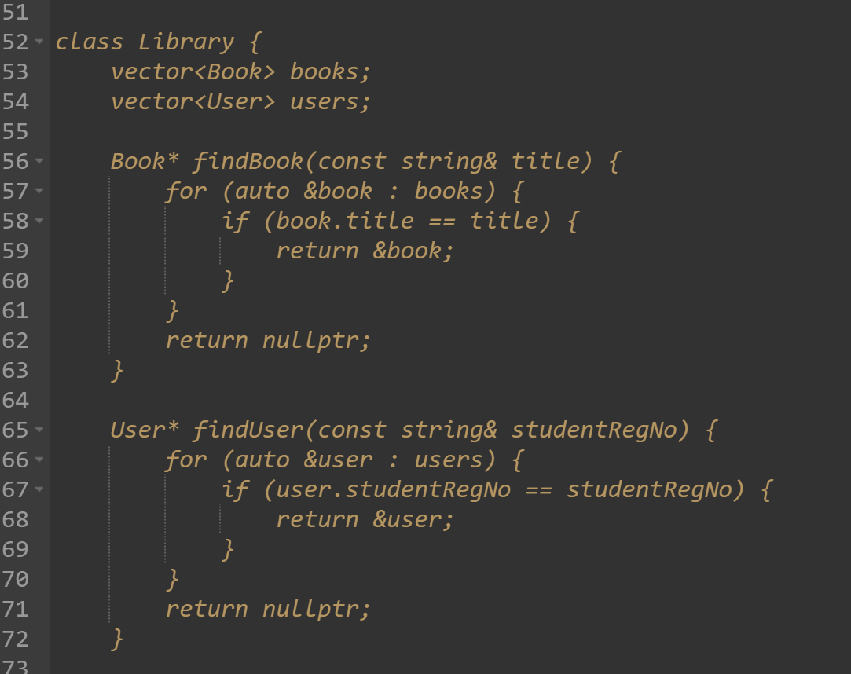
CODE OF LMS
Class Library:
Manages books and users.
Attributes:
books: List of all books.
users: List of all registered users.
Key methods:
addBook(), addUser(), borrowBook(), returnBook(), searchBook(), displayAllBooks(), displayAllUsers().

Slide 13
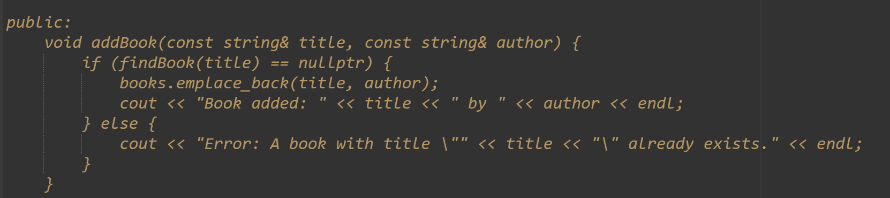
CODE OF LMS
The addBook function checks if a book with the given title already exists in the library using findBook.
If not found, it adds the book to the library's collection and displays a success message; otherwise, it shows an error indicating the book already exists.

Slide 14
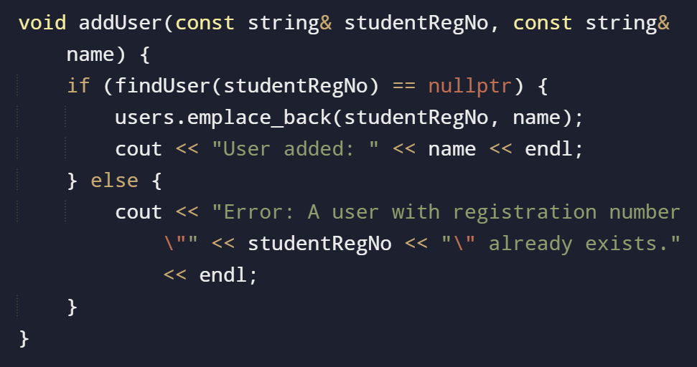
CODE OF LMS
The addUser function checks if a user with the given registration number already exists in the library using findUser.
If not found, it adds the user to the library's user list and displays a success message; otherwise, it shows an error indicating the user already exists.

Slide 15
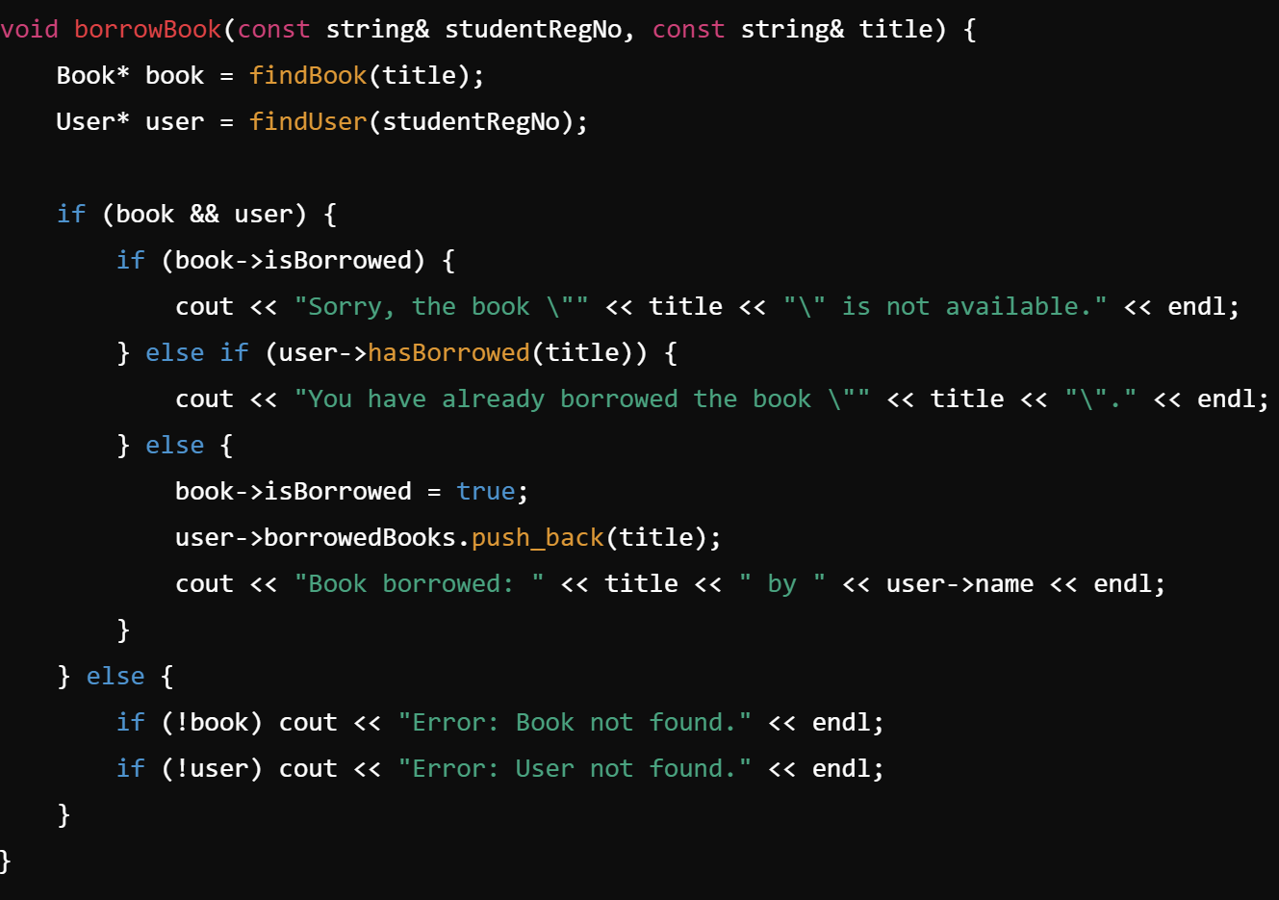
CODE OF LMS
The returnBook function handles the process of returning a borrowed book. It checks if both the book and user exist and validates if the book is marked as borrowed.
If the user has borrowed the book, it updates the book's status to "not borrowed," removes it from the user's borrowed list, and displays a success message.
Otherwise, it displays appropriate error messages for invalid conditions.

Slide 16
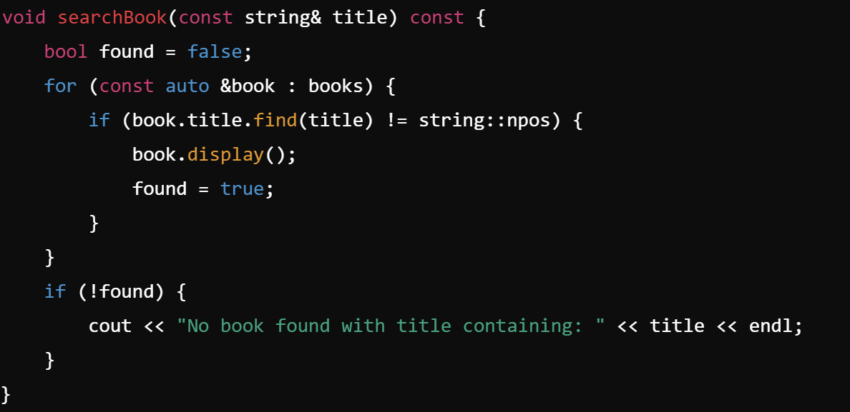
CODE OF LMS
The searchBook function searches for books in the library whose titles contain the given keyword. It iterates through all books and displays those that match.
If no matches are found, it outputs a message indicating no books were found with the specified title keyword.

Slide 17
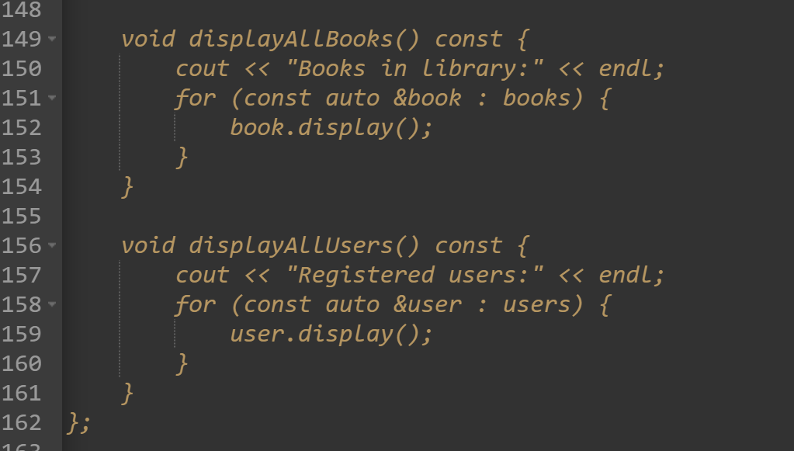
CODE OF LMS
The displayAllBooks function lists all the books in the library by calling their display method, showing their details.
Similarly, the displayAllUsers function lists all registered users, displaying their details using the display method of each user.

Slide 18
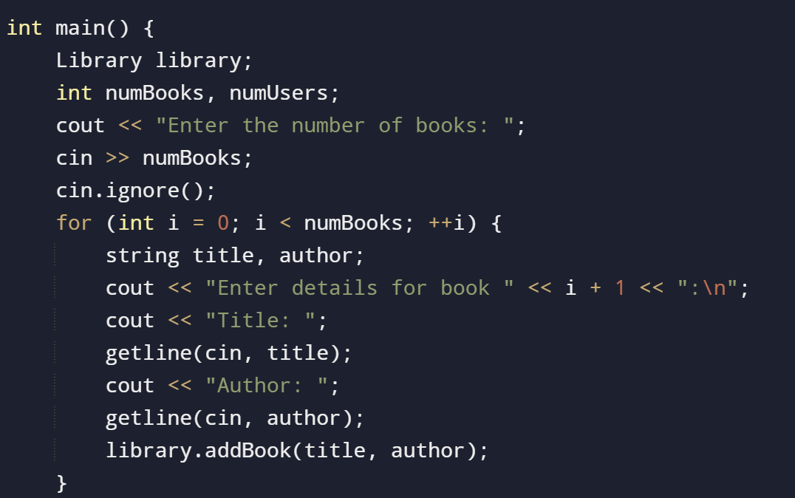
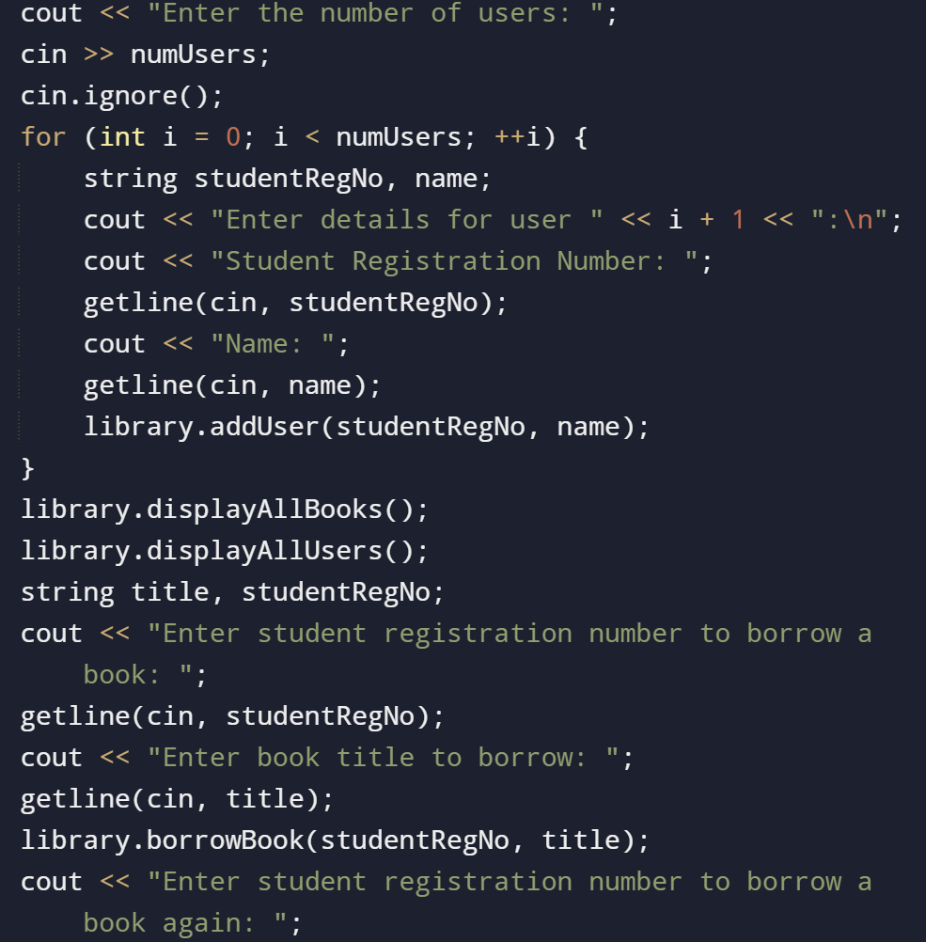
CODE OF LMS
MAIN FUNCTION OF THE CODE

Slide 19
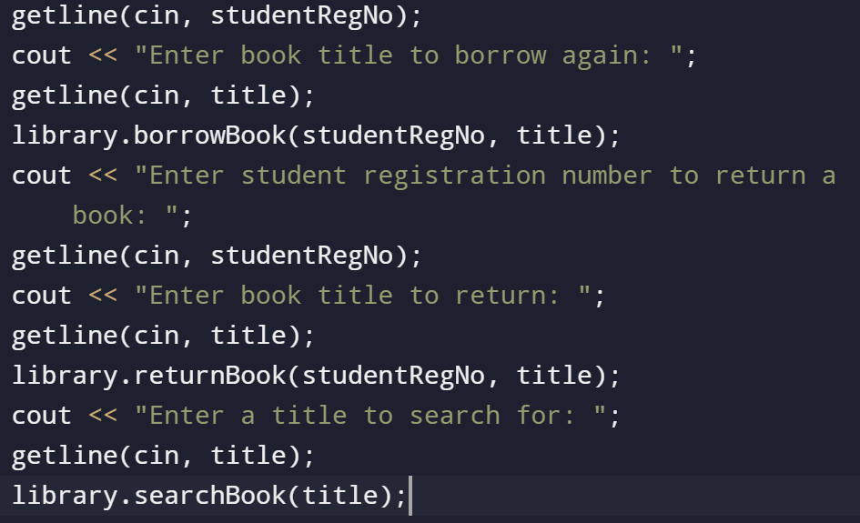
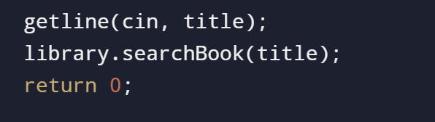
CODE OF LMS

Slide 20

CONCLUSION
The Library Management System simplifies library operations by managing books, users, and borrowing processes efficiently.
It ensures proper tracking, minimizes errors, and enhances accessibility, offering a user-friendly and organized solution for libraries

Slide 21


